Slide 1

Reliable diagnosis for pulmonary diseases
1
Objective scoring of physiologically-induced dyspnea
Zijing Zhang,
PhD Candidate,
2019-Expected May 2023,
School of Electrical and Computer Engineering
Cornell University, Ithaca, NY
Notes:
Hello, welcome to my A exam. The topic of my presentation is ….

Slide 2
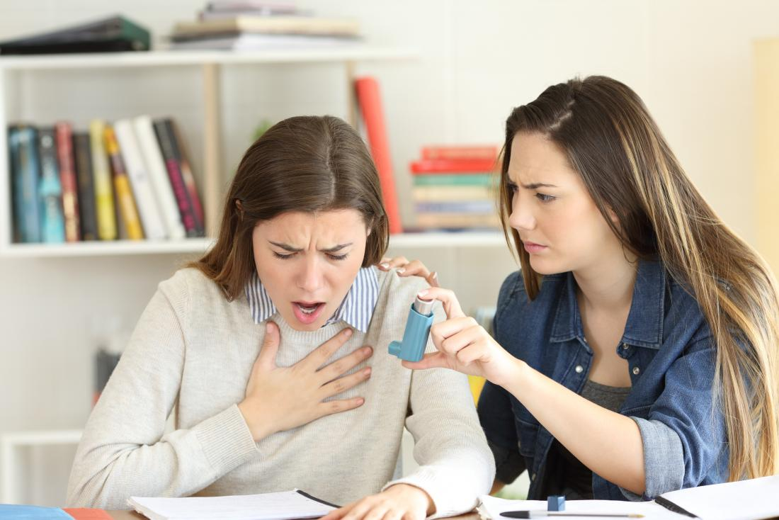
Objective scoring of physiologically-induced dyspnea
Dyspnea usually self-reported by
Borg scale 0-10:
Dyspnea : shortness or difficulty of breathing
Subjective and
Problematic ??
Chronic dyspnea due to COPD, asthma, lung diseases.
Notes:
Dyspnea, also known as the patient’s feeling of difficult or labored breathing, is one of the most common symptoms for respiratory disorders. Dyspnea is usually self-reported by patients using, for example, the Borg scale from 0 – 10, which is subjective and problematic for those who refuse to cooperate or cannot communicate. The objective was to develop a learning-based model that can evaluate the correlation between the self-report Borg score and the respiratory metrics for dyspnea

Slide 3
Experimental Setup
2 wearable RF sensors &
2 invisible RF sensors integrated to chair
On thorax and abdomen position
Simulate dyspnea on healthy subject (N=32) by:
10 mins exercise
Wear thick facemask
Self reported dyspnea score for each routine is collected.
Notes:
A non-invasive wearable radio-frequency sensor by near-field coherent sensing was employed to retrieve continuous respiratory data with user comfort and convenience. Self-report dyspnea scores and respiratory features were collected on 32 healthy participants going through various physical and breathing exercises. A machine learning model based on the decision tree and random forest then produced an objective dyspnea score. . The experimental system

Slide 4
Normal breathing
Normal breathing with a facemask
Normal breathing after physical exertion
Breathing exercise
Breathing exercise after physical exertion
An example of NCS respiratory waveforms during the study protocol. The illustration period is truncated from 10 to 90 s of each routine. Green curves indicate absence of dyspnea, and red curves indicate some degrees of dyspnea.

Slide 5

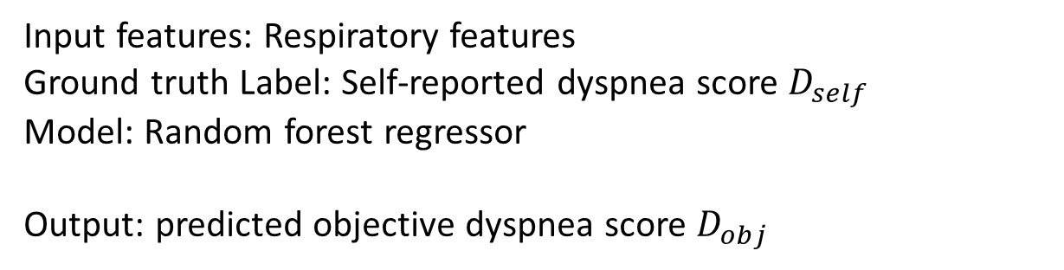
Signal processing and Machine Learning model
1. Extract respiratory parameters
from waveforms
2. Respiratory features (n=15)
from respiratory parameters.
 | Breath rate (BPM) | Peak-to-peak (a.u.) | Inhalation interval (s) | Exhalation interval (s)
Coefficient of variation | CoV_{BR} | CoV_{PP} | CoV_{IN} | CoV_{EX}
Mean | µ_{BR} |  | µ_{IN} | µ_{EX}
Autocorrelation | R1_{BR} | R1_{PP} | R1_{IN} | R1_{EX}
Successive differences | R2_{BR} | R2_{PP} | R2_{IN} | R2_{EX}
3. ML Model for dyspnea scoring
Input features: Respiratory features
Ground truth Label: Self-reported dyspnea score $D_{self}$
Model: Random forest regressor
Output: predicted objective dyspnea score $D_{obj}$
$$\text{Accuracy}\text{: }\text{η}=1−\frac{\left|D_{obj} − D_{self}\right|}{9}$$
Notes:
For unseen data as well as unseen participants, the objective dyspnea score can be in reasonable agreement with the self-report score, and the importance factor of each respiratory metrics can be assessed.

Slide 6
Prediction accuracy for dyspnea score
B&A plots between D_{self} and D_{obj}
Data set | NCS
Model | Random forest
Feature importance | μ_{BR}=40.2% R2_{BR}=15.1% R2_{EX}=7.5%
Mean η by k-fold cross-validation | 0.866
Mean η by leave-one-participant-out cross-validation | 0.881
η for testing data | 0.907
D_{self} - D_{obj}
(D_{self +} D_{obj} )/2
The method formulates a baseline for clinical dyspnea assessment.
Notes:
An objective dyspnea score can potentially complement or substitute the self-report for dyspnea. The method can potentially formulate a baseline for clinical dyspnea assessment and help caregivers track dyspnea continuously.

